Slide 1
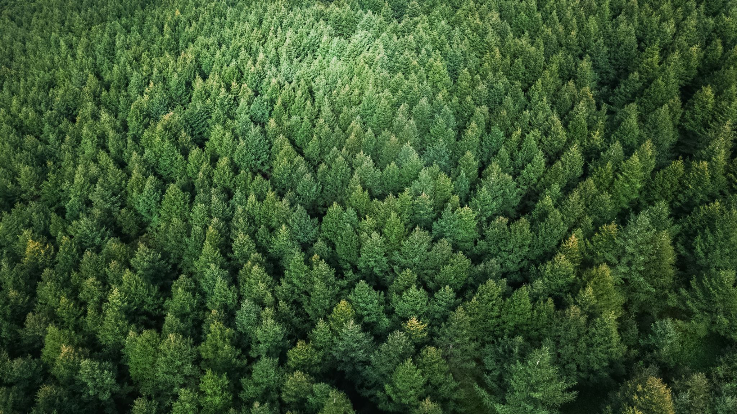
Forest Cover Type Prediction Project
Made by:
Abdelsalam Mohanad
Attia Nada
El-Sabow Shady

Slide 2

outlines
Problem definition
EDA analysis on the data provided
Visualization
Supervised Approach Q1
Preprocessing and Features Engineering
Supervised Approach models Q2
Supervised Approach models Q3
Unsupervised Approach model Q4
PKI model
Hyperparameter tunning

Slide 3
Project Flow:
Problem definition
EDA analysis on the data provided
Visualization
Supervised Approach Q1
Preprocessing and Features Engineering
Supervised Approach models Q2
Supervised Approach models Q3
Unsupervised Approach model Q4
PKI model
Hyperparameter tunning

Slide 4
Project Problem:
Features of data
Elevation.
Aspect
Slope.
Horizontal_Distance_To_Hydrology
Vertical_Distance_To_Hydrology.
Horizontal_Distance_To_Roadways
Hillshade_9am.
Hillshade_Noon.
Hillshade_3pm.
Horizontal_Distance_To_Fire_Points.
Wilderness_Area (4 binary columns, 0 = absence or 1 = presence)
Soil_Type (40 binary columns, 0 = absence or 1 = presence).
target
cover type 1 = Spruce/Fir
cover type 2 = Lodgepole Pine
cover type 3 = Ponderosa Pine
cover type 4 = Cottonwood/Willow
cover type 5 = Aspen
cover type 6 = Douglas-fir
cover type 7 = Krummholz
models

Slide 5

insights about the data (EDA)

Slide 6
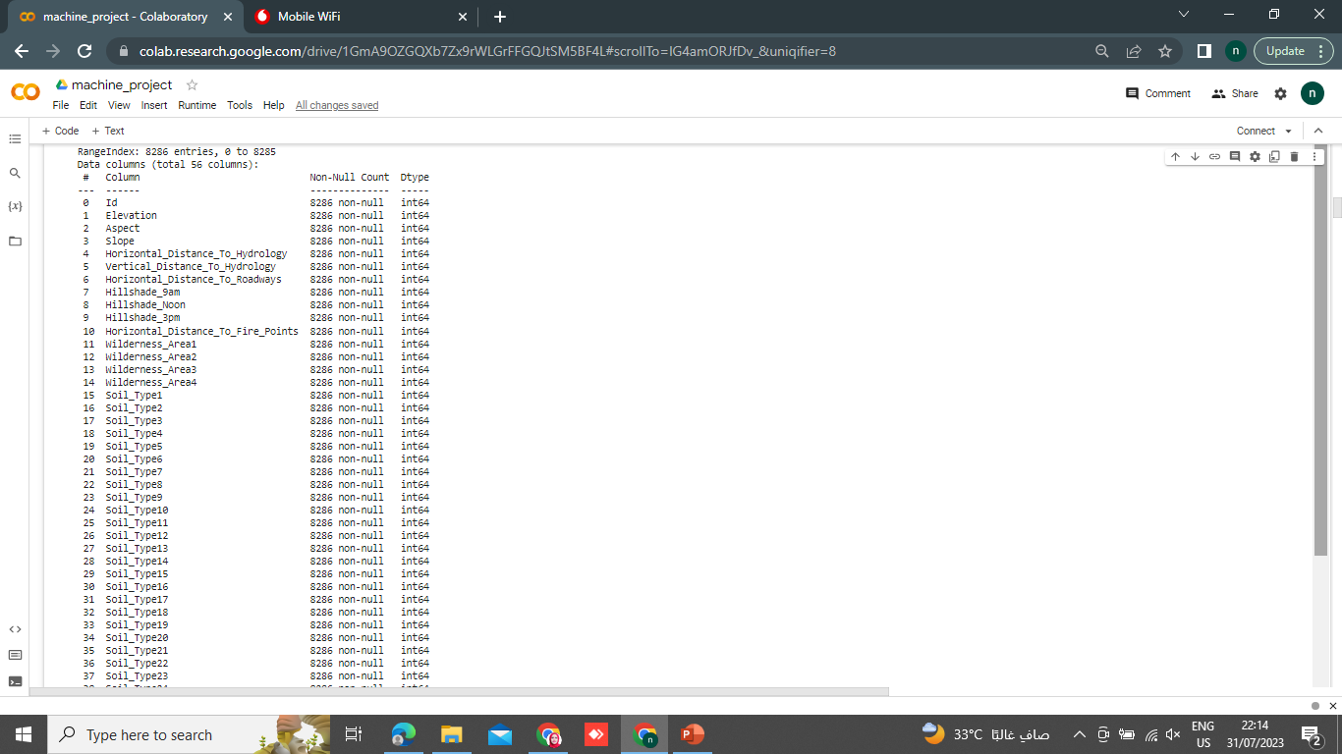
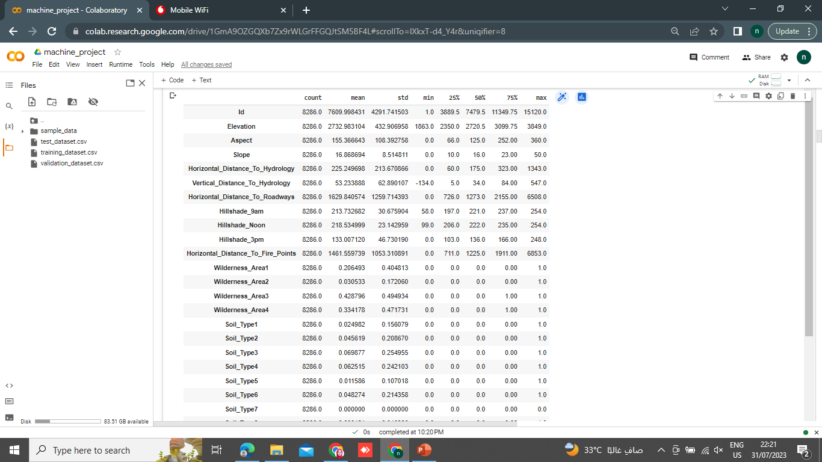

insights about the data (EDA)
Notes:
"Our datasets consists of 3 dataset used :[train & validation & test]
In Train data their are a 8286 samples , 55 features and one target,
In Test data their are a 1525 samples , 55 features and one target,
In validation data their are a 1498 samples , 55 features and one target,
the total data contains 11309 rows × 56 columns
where each sample is a numerical measurement of various characteristics of a Forest. The features include the Elevation, Aspect , Slope ,Horizontal_Distance_To_Hydrology , Vertical_Distance_To_Hydrology , , Horizontal_Distance_To_Roadways ,Hillshade_9am ,Hillshade_Noon , Hillshade_3pm ,Horizontal_Distance_To_Fire_Points , 4 binary data of Wilderness_Area, 40 binary data of Soil_Type,7 types of Cover_Type.
The data are in the form of a CSVs files.
The data dosen't containg any Null values or missing data

Slide 7
insights about the data (EDA)
# search for the unique values
Id has unique values (8286)
Elevation has unique values (1580)
Aspect has unique values (361)
Slope has unique values (50)
Horizontal_Distance_To_Hydrology has unique values (362)
Vertical_Distance_To_Hydrology has unique values (383)
Horizontal_Distance_To_Roadways has unique values (2443)
Hillshade_9am has unique values (168)
Hillshade_Noon has unique values (132)
Hillshade_3pm has unique values (243)
Horizontal_Distance_To_Fire_Points has unique values (2115)
Wilderness_Area1,Wilderness_Area2 ,Wilderness_Area3 ,Wilderness_Area4 have unique values (2)
All Soil_Type from 1 to 40 except Soil_Type7 and Soil have unique values (2) Soil_Type7 and Soil have unique values(1)

Slide 8
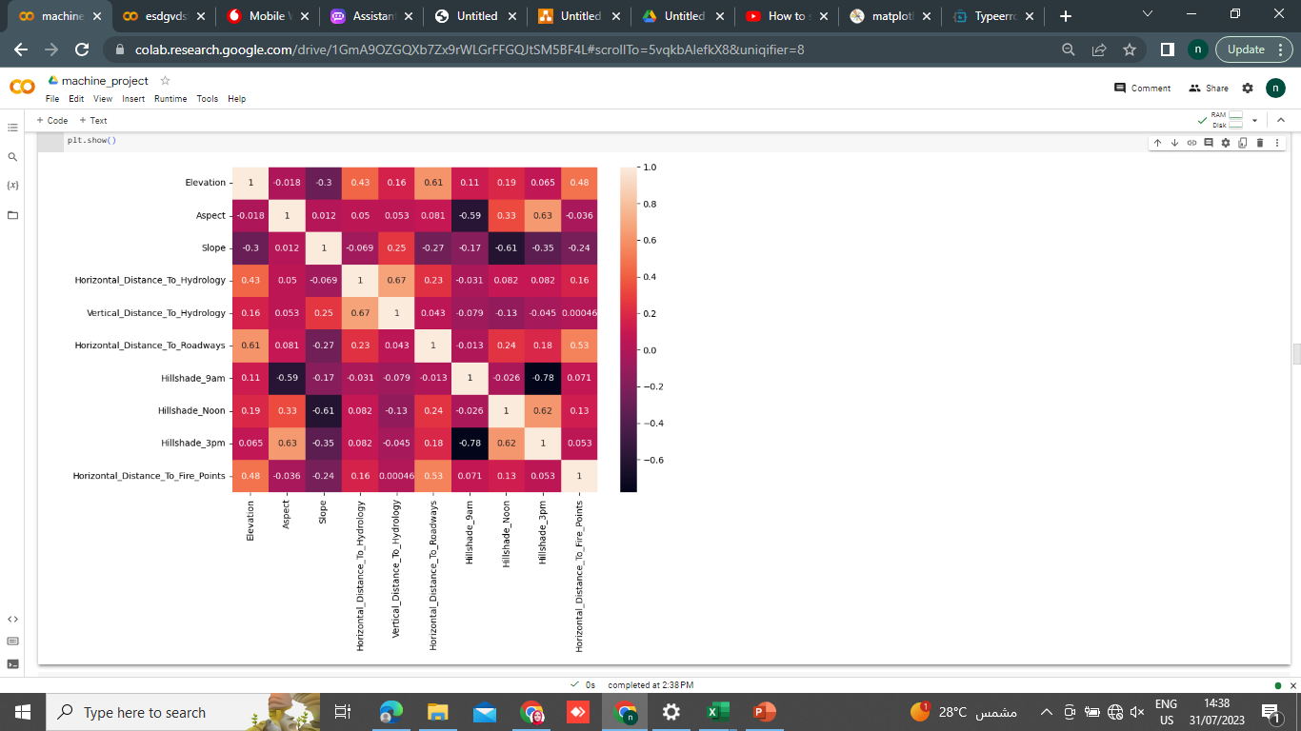
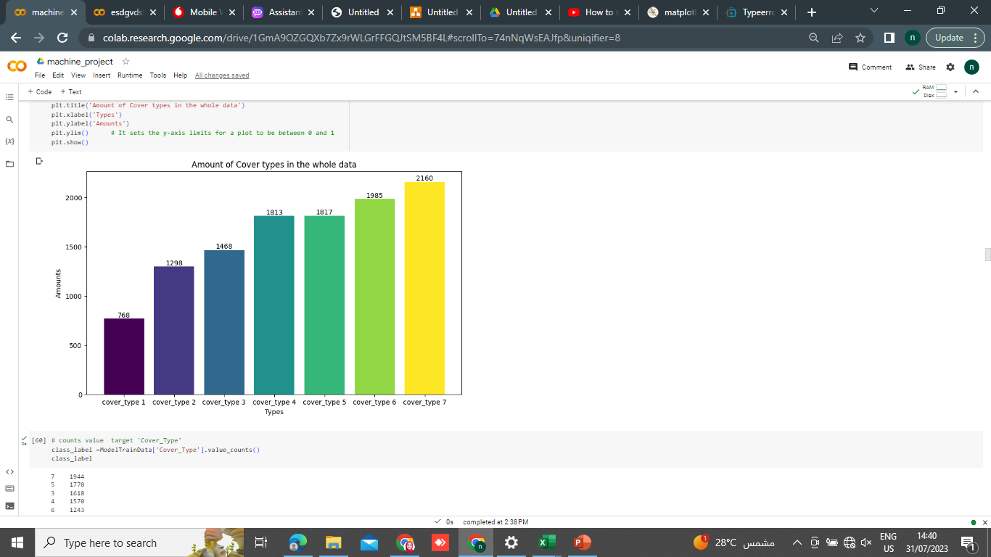
insights about the data (EDA)

Slide 9
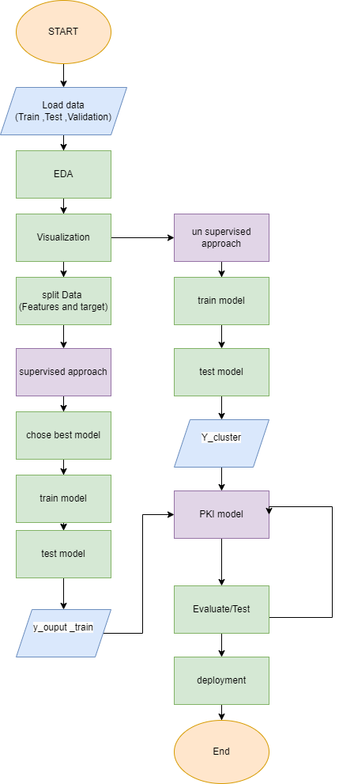
Flow Chart

Slide 10
Visualization:

Slide 11
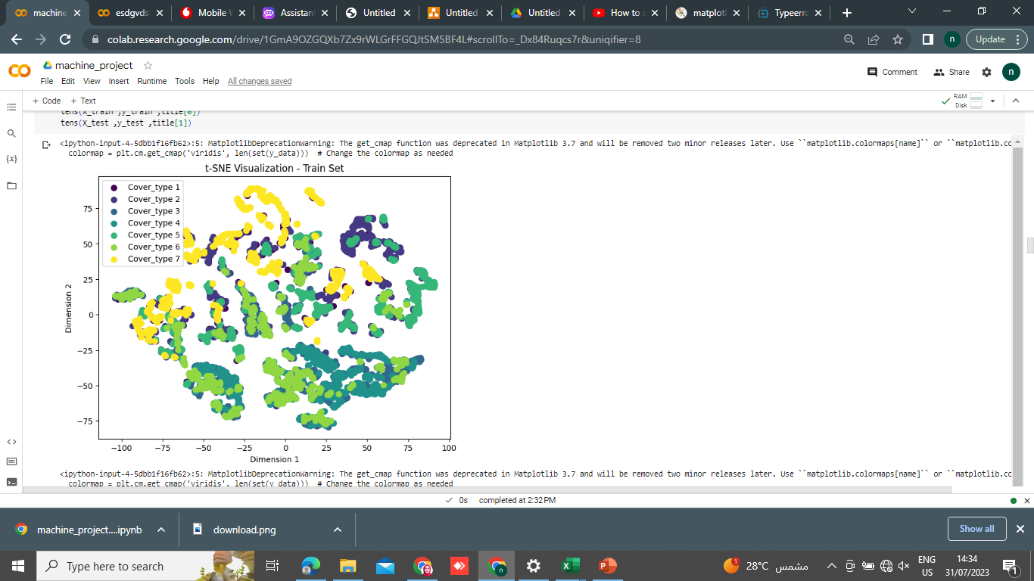
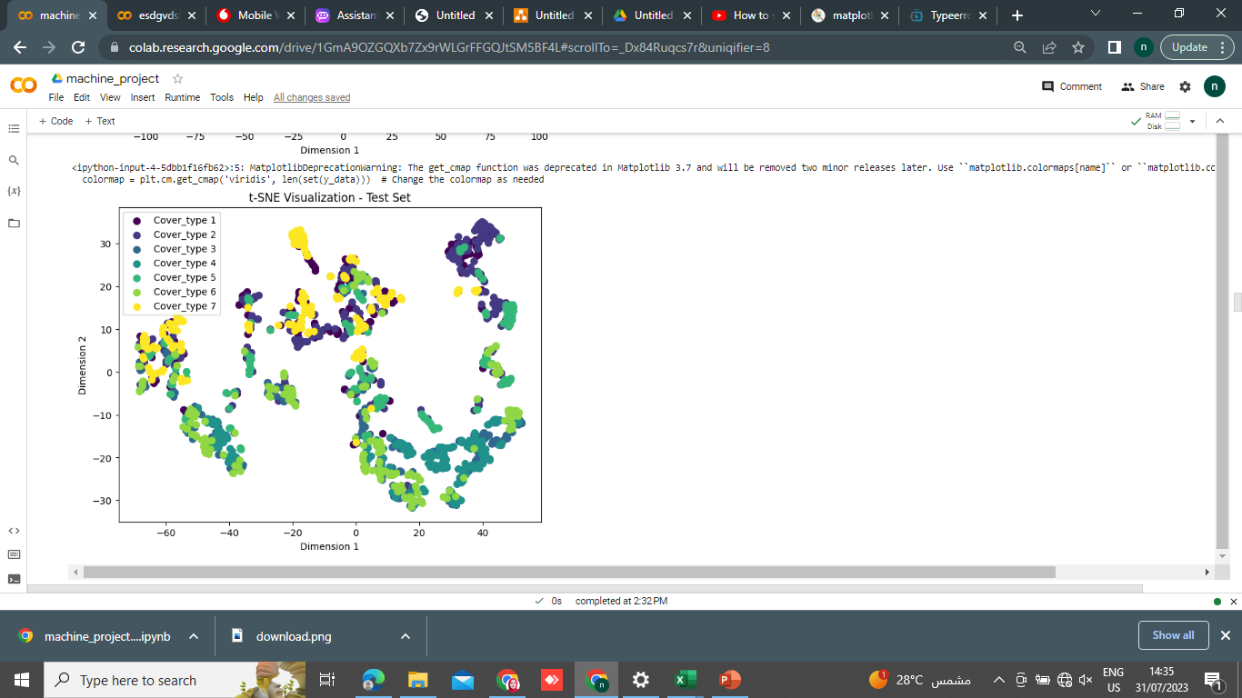
Complexity of data

Slide 12
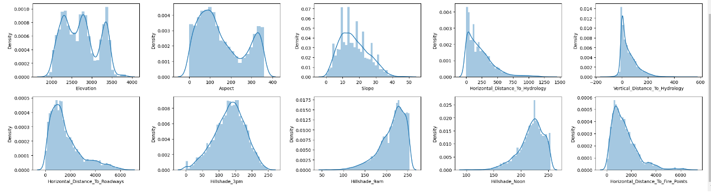
Visualization:(distribution)

Slide 13
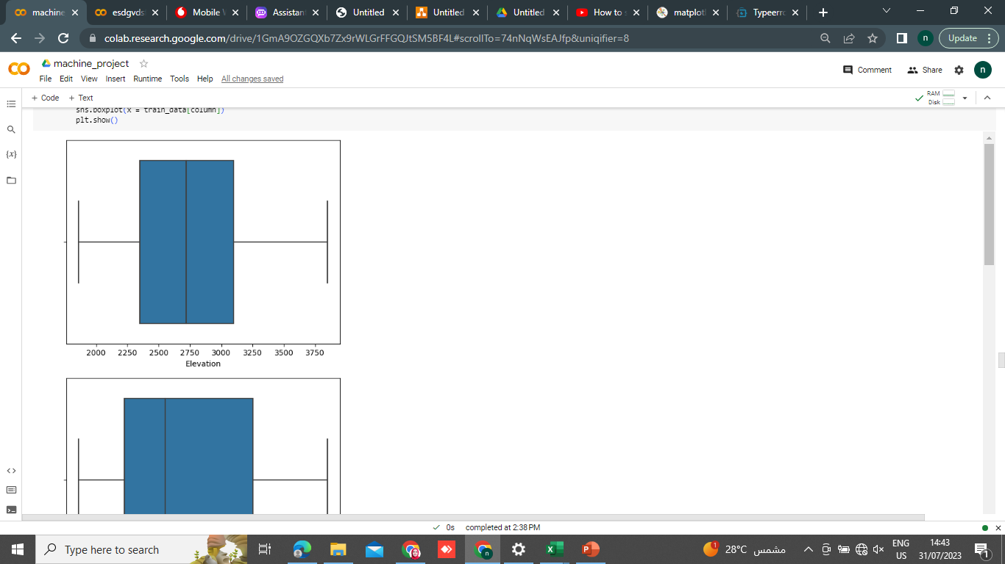
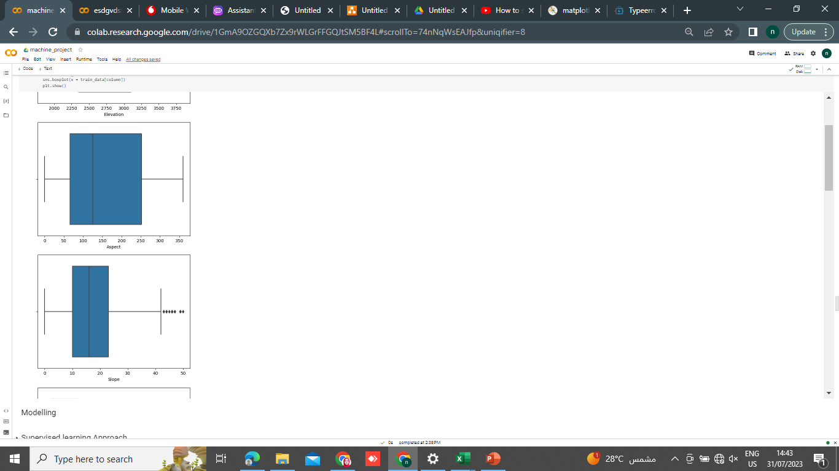
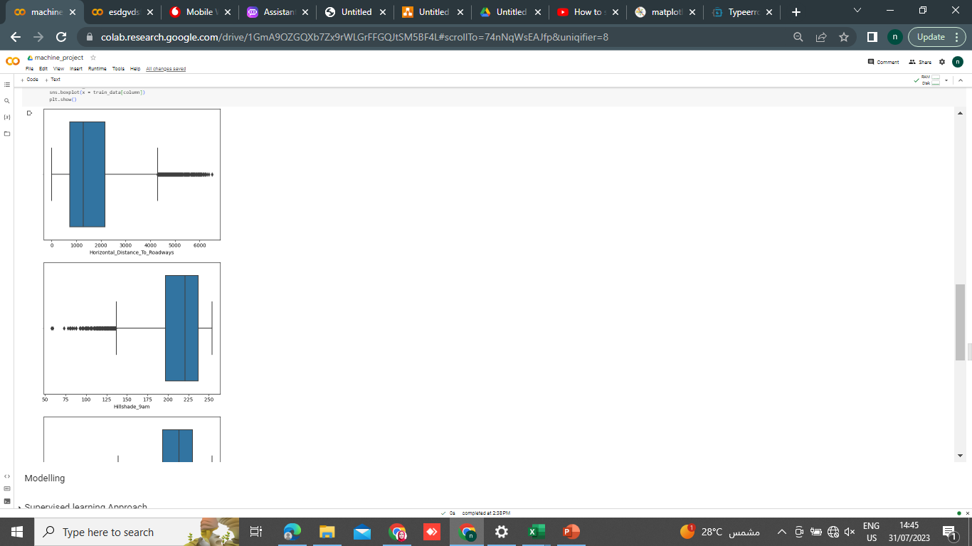
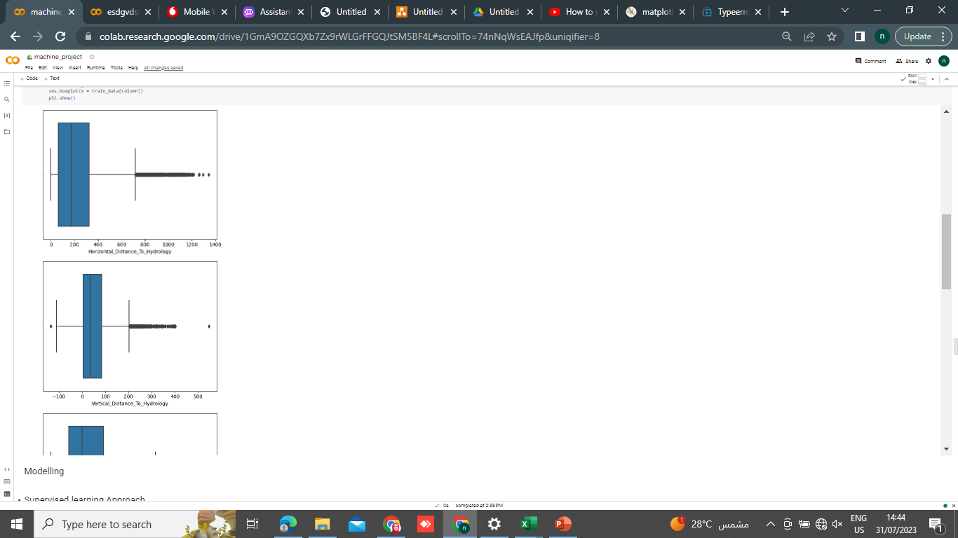
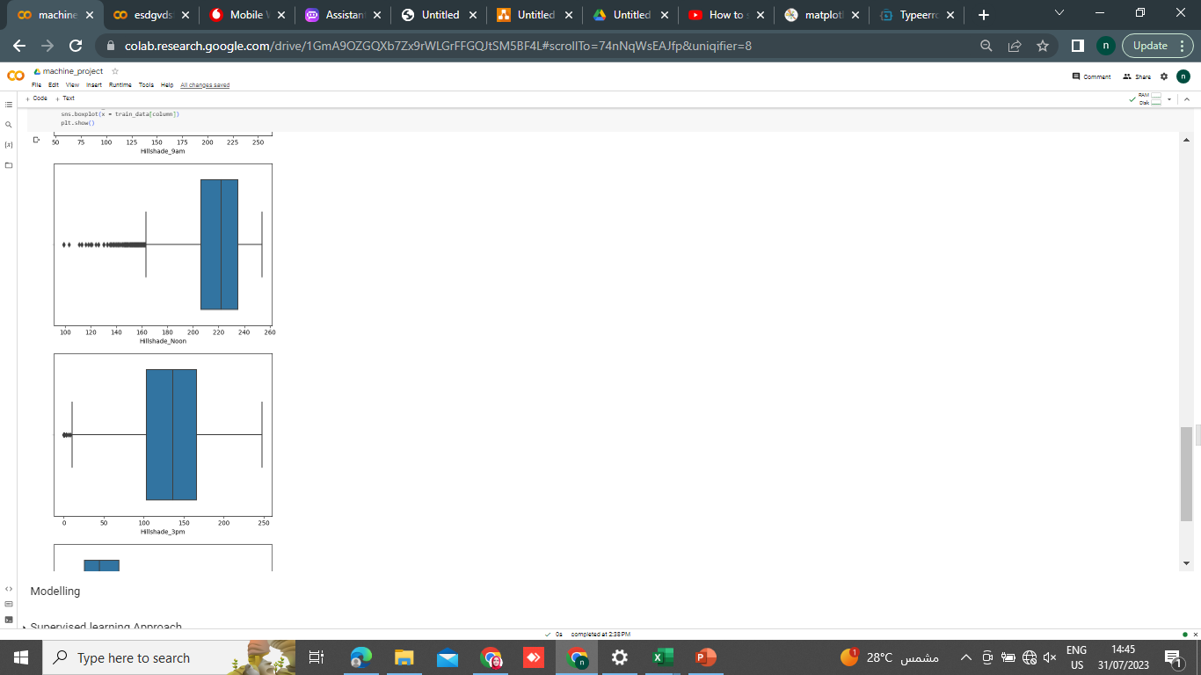
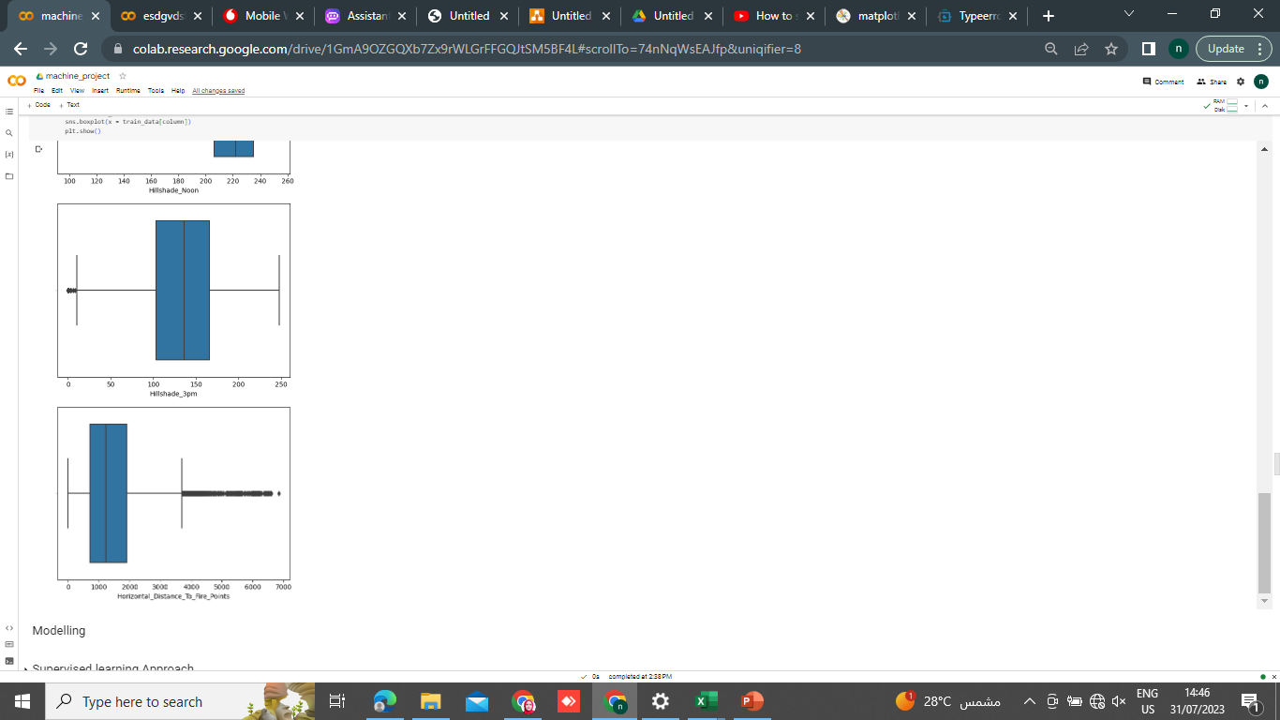
Outliers

Slide 14
Modelling

Slide 15
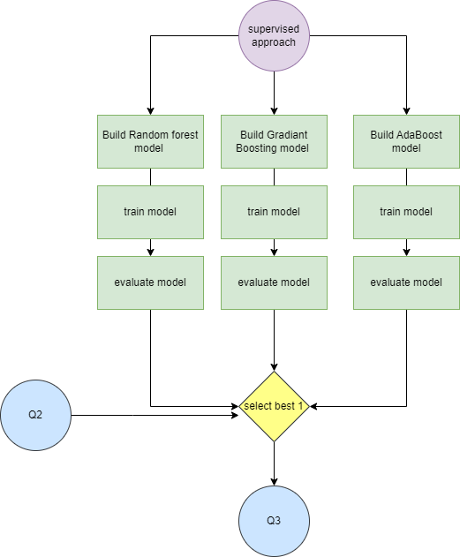
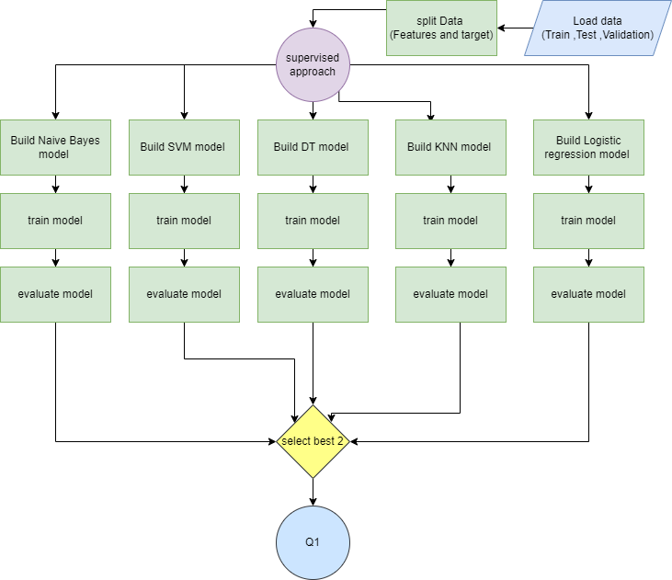
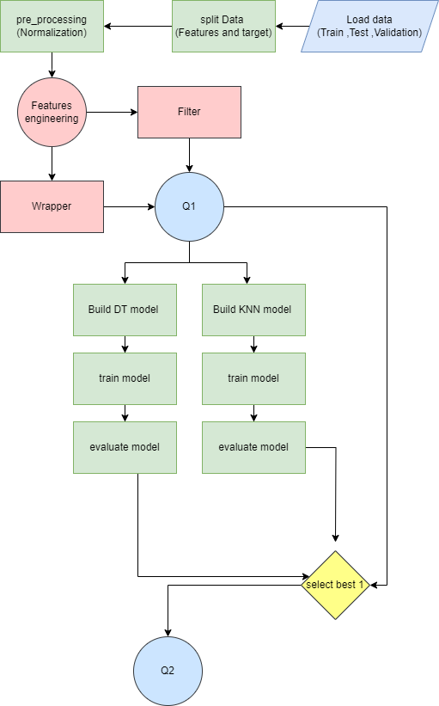
Supervised Learning

Slide 16
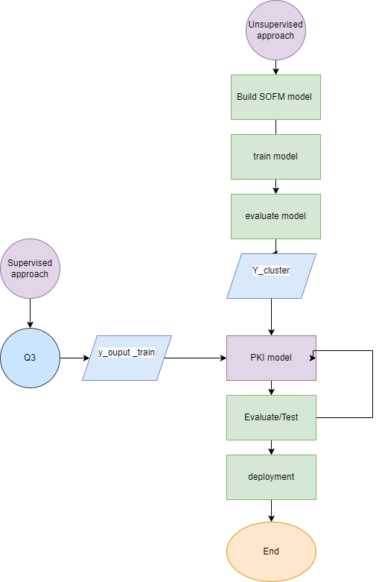
Unsupervised Learning

Slide 17
Supervised Learning(Q1)

Slide 18
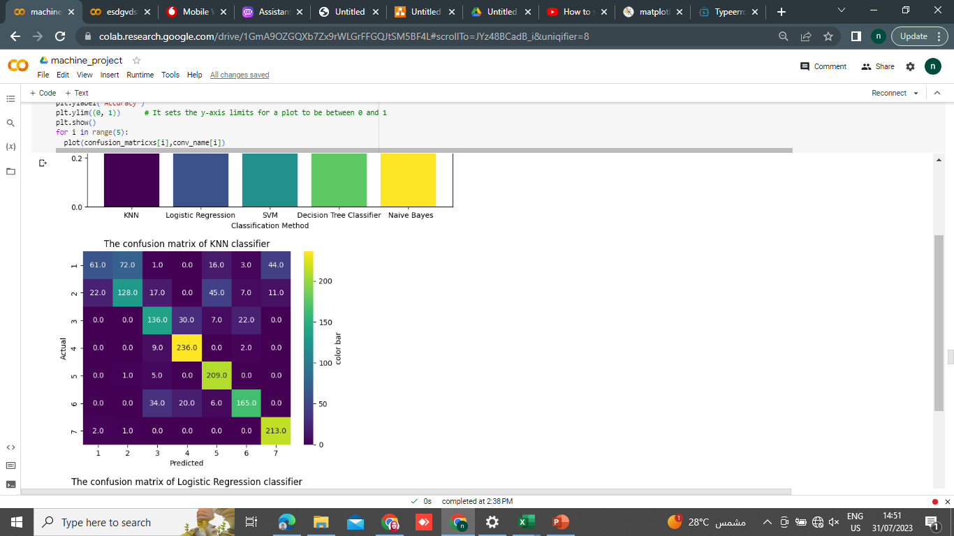
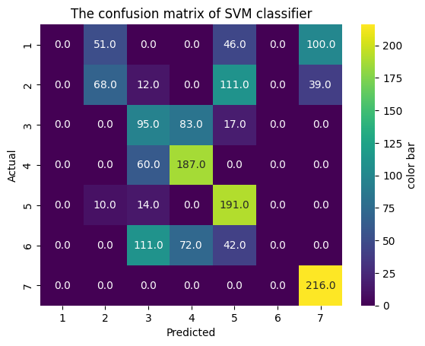
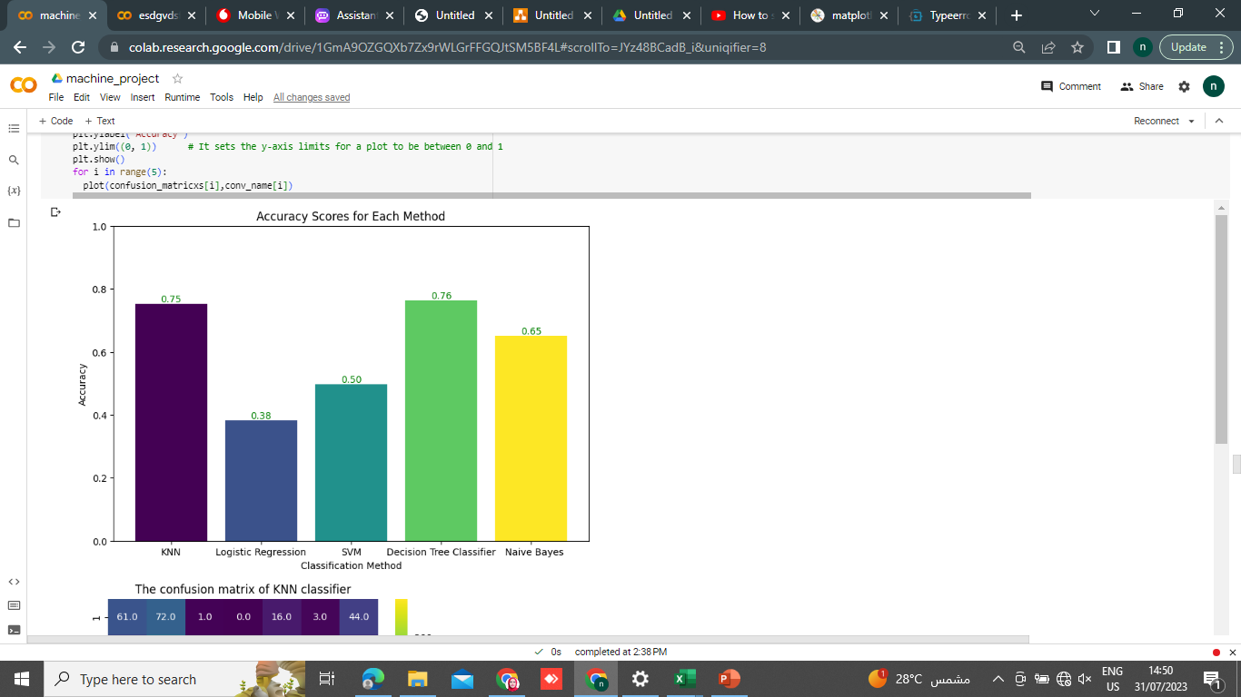
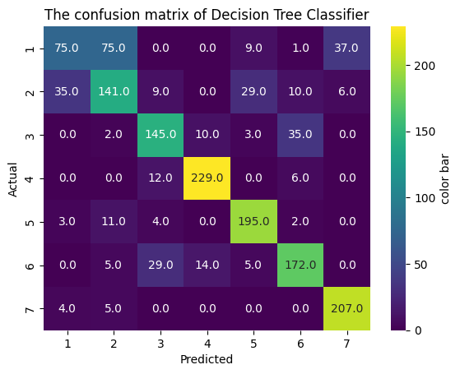
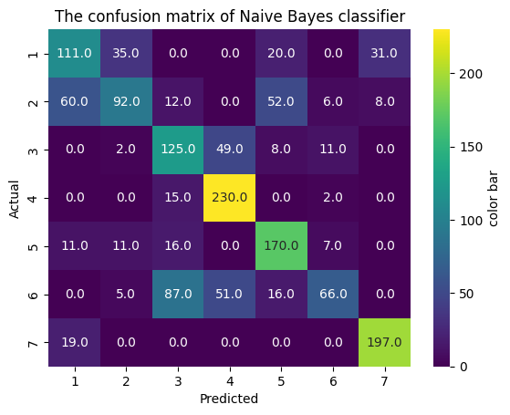
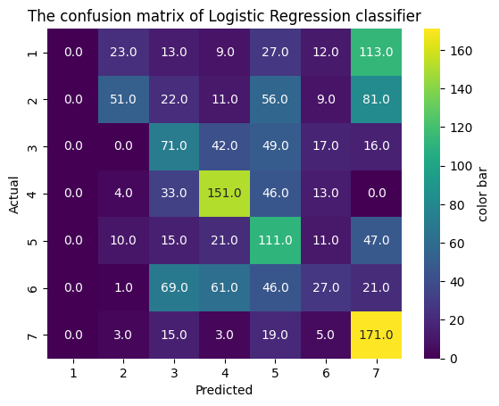

Slide 19
Supervised Learning(Q2)
Notes:
SelectKBest is a feature selection method .It is used to select the k most important features from the input data based on a specified scoring function. we will use:
the chi-squared (chi2) scoring function.
and apply it into KNN and Decision tree

Slide 20
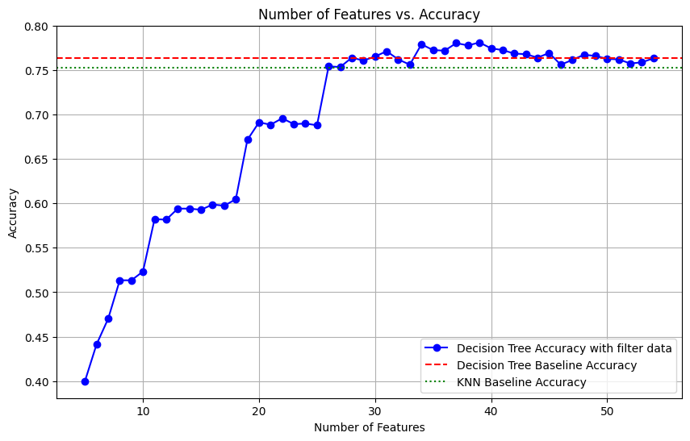
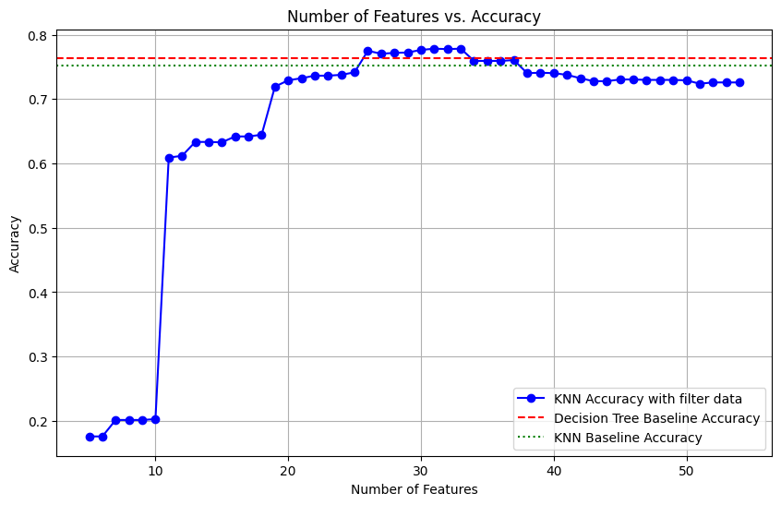
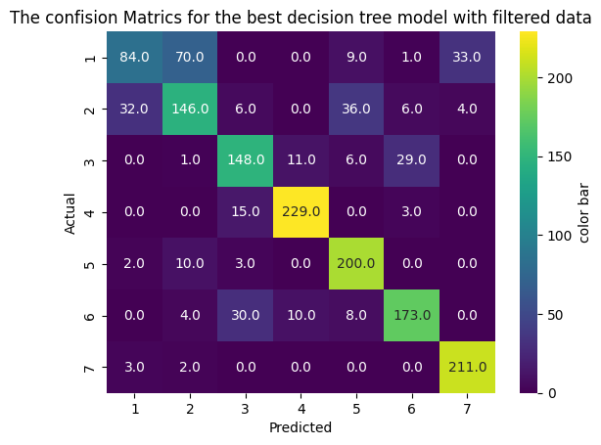
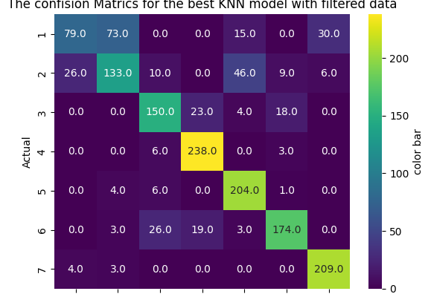
Features Engineering (Filter)

Slide 21
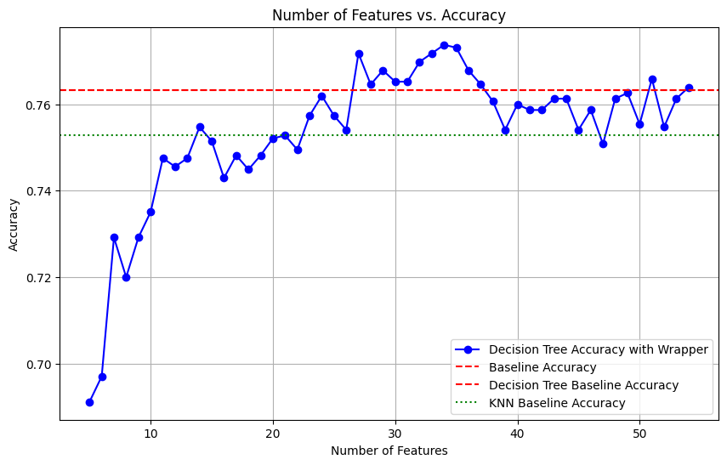
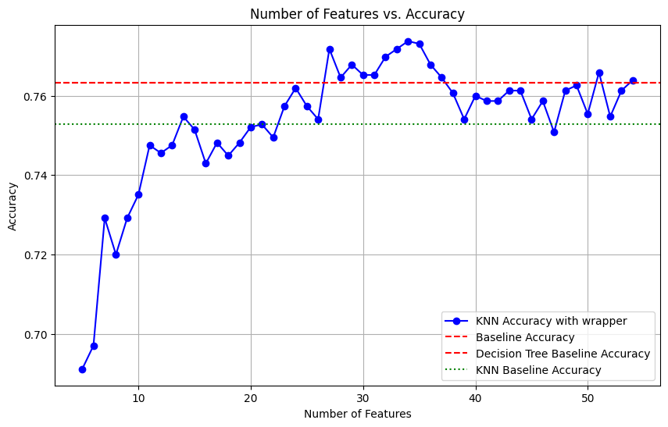
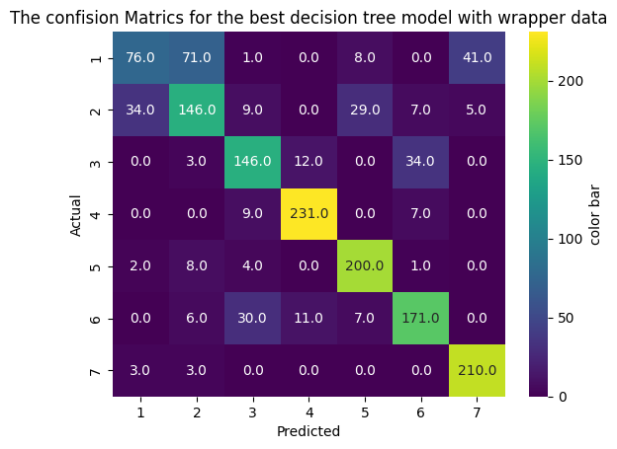
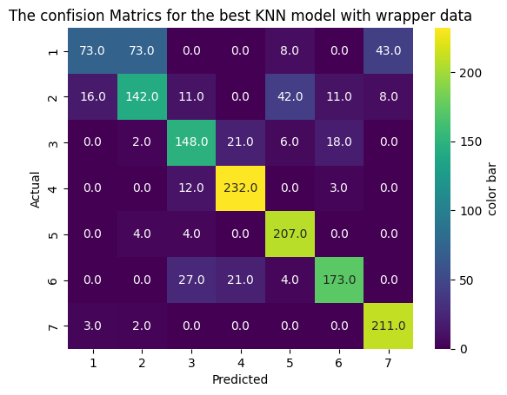
Features Engineering (Wrapper)

Slide 22
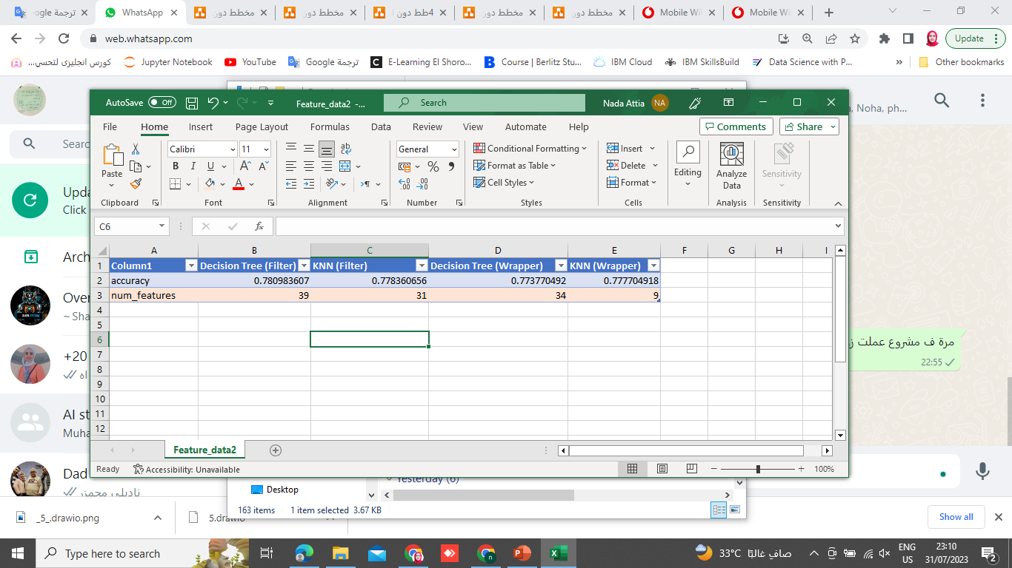
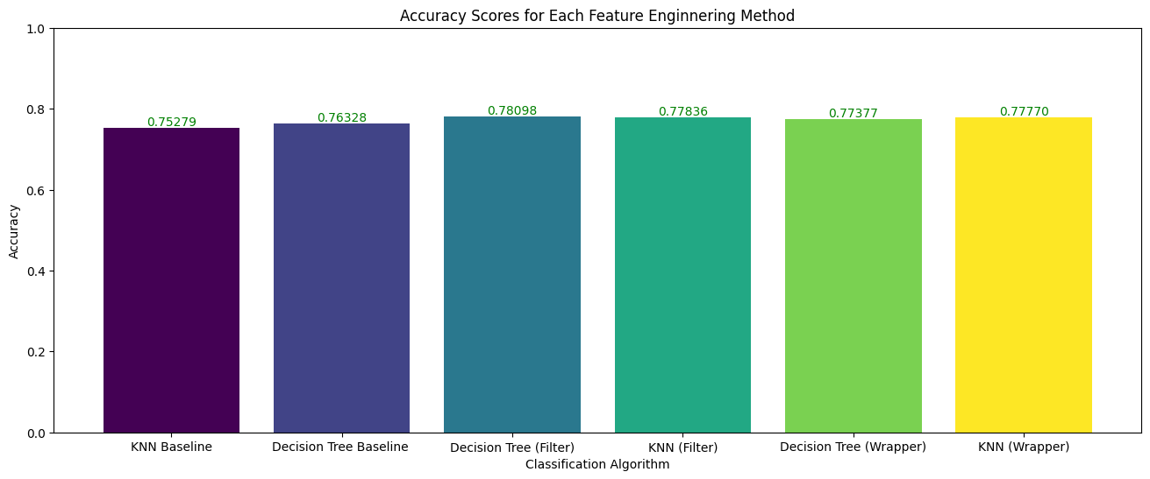

Slide 23
Supervised Learning(Q3)

Slide 24

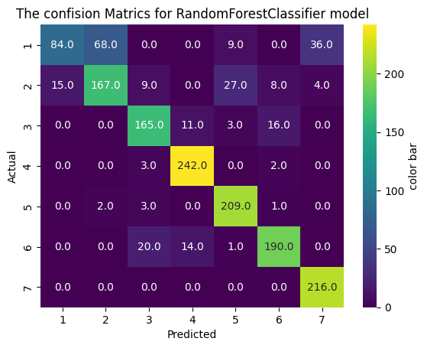
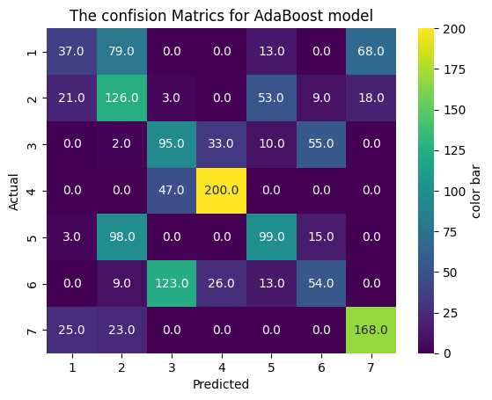

Slide 25
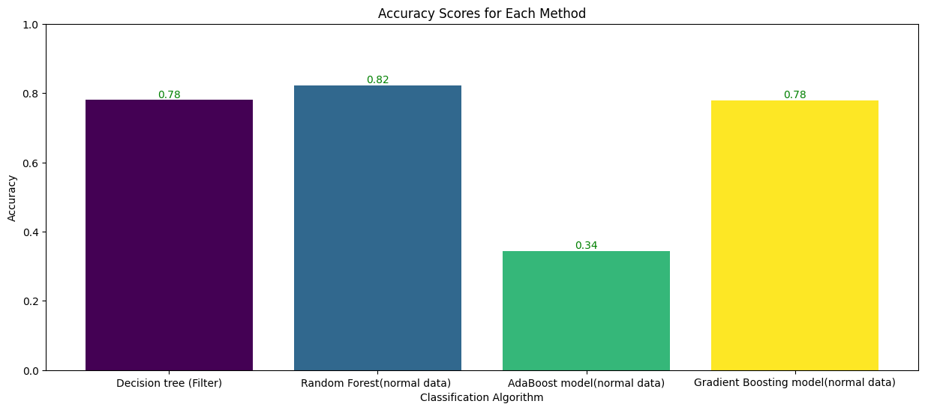
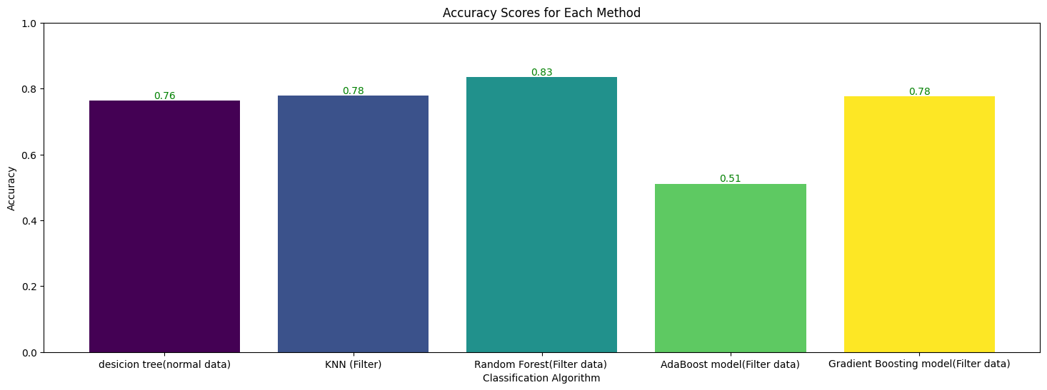

Slide 26
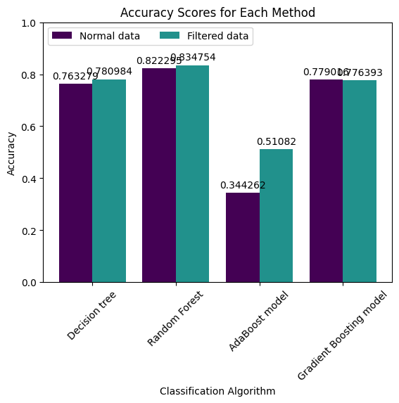
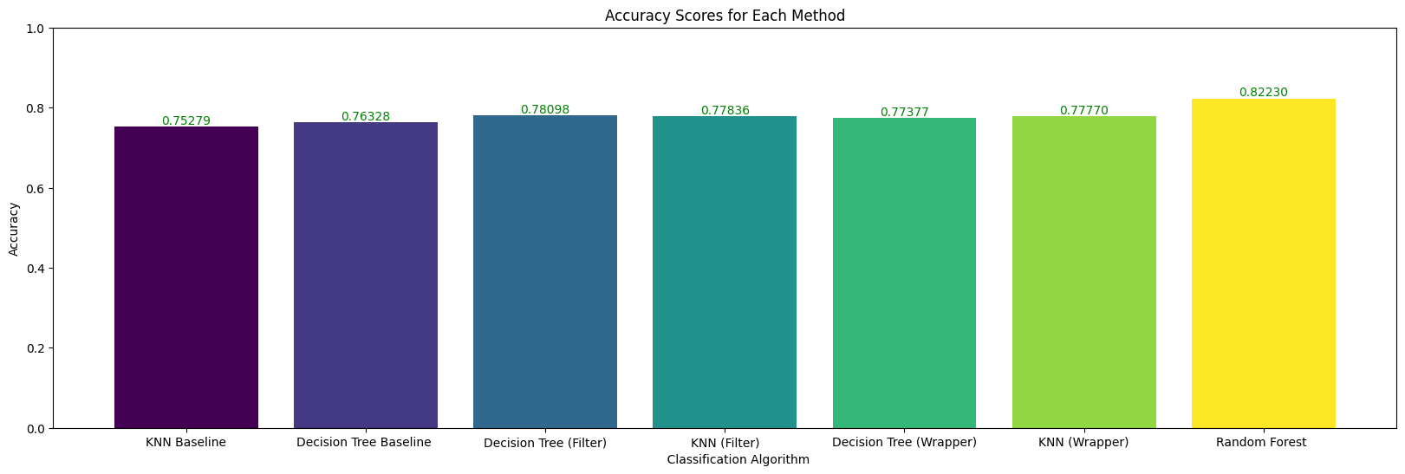

Slide 27
PKI model Q4

Slide 28
the purpose of PKI
adding more clusters to the y Output
and redirecting it as an input to a deep nueral network

Slide 29
What is PKI
adding more clusters to the y Output
and redirecting it as an input to a deep neural network

Slide 30
What is PKI

Slide 31
purpose of PKI method
1- Improve supervised model
2- Generate additional features
3- combination of models will increase hyper parameter possibilities

Slide 32
implementation of PKI
1- train random forrest and put the output in a data frame for train and test
2-train sofm and get the clusters in a data frame for train and test
3- use concatenation
4- label encoding
5- train the DNN
6- evaluate
7- tune

Slide 33
Hyperparameter tunning(Q5)

Slide 34
HOW?
combination of models will increase hyper parameter possibilities
because it will allow you to tune more combinations of hyper parameters

Slide 35
implementation of hyper parameter tuning
1- set the configuration of hidden layers 2- change epochs, batch_size and learning rate repeat until we get the complete picture
then we can obtain the best combination.

Slide 36
conclusion
Without preprocessing data and making Features Engineering approaches ,the accuracy for different machine learning models will be lower than it.
When you used a default parameter of the machine learning models, it will give you a low accuracy but if you change parameter and make a hyperparameter optimization, you will get better accuracy than before...take into account that uses it method related to your dataset as each data need to set it's model parameter.
After making a Features Engineering with filter method and wrapper( best select k) it will give you a higher accuracy.
The different model as random forest and ensemble will give you a high accuracy when use it with filter data The winner from the supervised approaches is random forest with filtered data

Slide 37
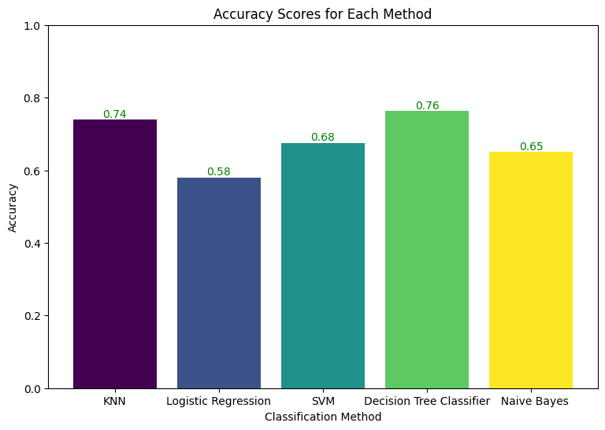
Hyperparameter tunning For supervised ML models

Slide 38
Resource
You will find more visualization in this note_book
https://colab.research.google.com/drive/1oyeQFiwsys5DezqEsKI_VJpnR1mzwz66?usp=sharing

Slide 39
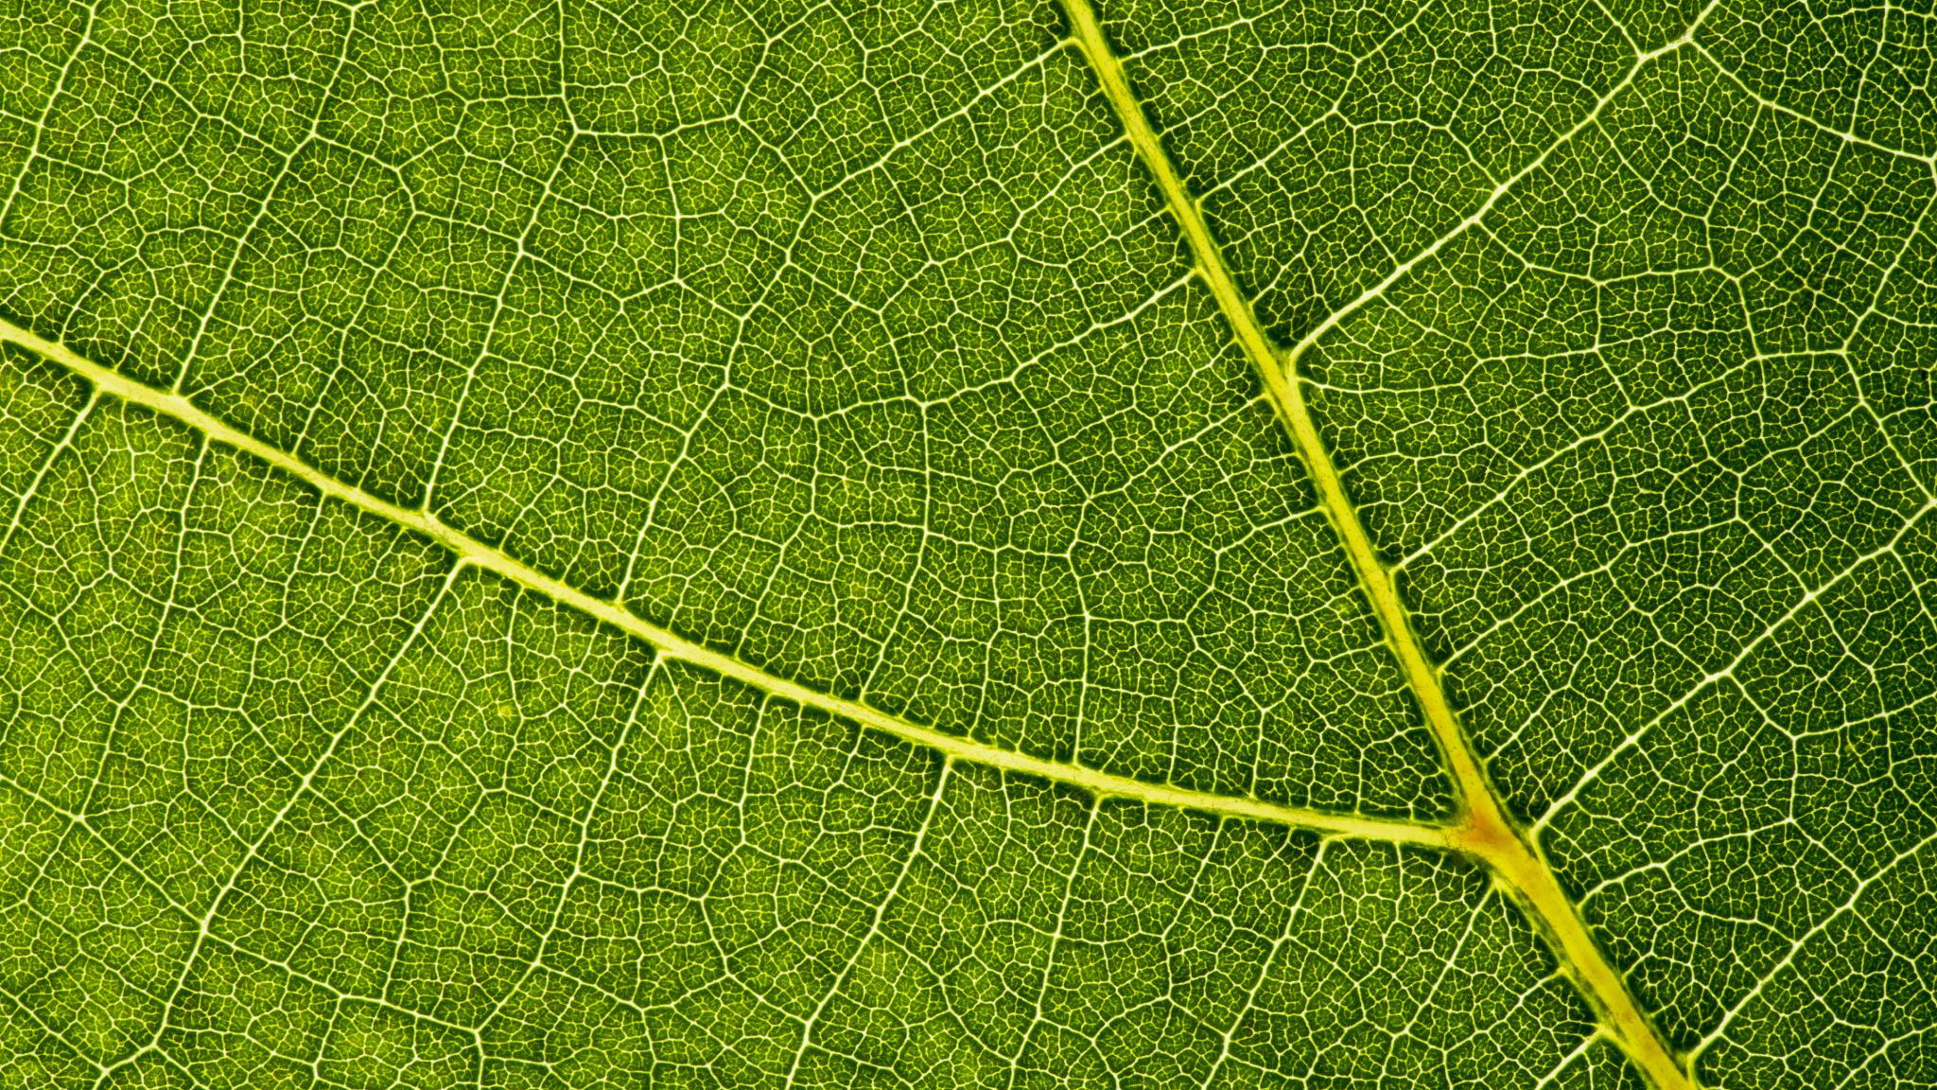
Thanks

